Slide 1
Quick(en) and Easy Budgeting Jane Wilson Treasurer, STC Board of Directors Timothy Esposito President, STC-Philadelphia Metro Chapter

Slide 2
Budgeting and Community Funding Jane Wilson Treasurer, STC Board of Directors

Slide 3
STC Community Funding
Yearly Budget = Funding Request
Requirements:
Current on Yearly Financial Reporting
Current on 990 tax filing
Must meet deadline for budget filing
(or request extension)
Funding is based on the number of members in your community (as of Aug 31)
Chapters: $15 per member
SIGs: $4 per member
Note: Community fees paid by members go toward all support costs for communities (Other costs also include direct staff support, CAC support, IT support, and overhead)

Slide 4
2017 Funding Process
Plan programs and services for 2017
Create budget based on program goals and previous experience
Use past budgets for reference
Consider actual income/expenses
Submit budget for review
Expect a response in 3-6 weeks
Chapters receive funding in one payment
SIG funds are earmarked; expenses are paid as received and reported monthly
Notes:
Review
Are revenues greater than expenses
Are resources being used for broad cross section of members.
Meetings – do revenues meet expenses
Are there other sources of revenues besides dues
Communities with leaders going to Summit – Are funds freed up by accepting registration being used for members?
Are reserves increasing.

Slide 5
Things to Consider
Self-sustaining programs (generally)
Reserves? 12-24 months of expenses
Provide best value to your members!
Common Recommendations:
Web hosting expense
High banking expense
High mail service expense
Funding gap or non-sustainable programming
High reserves
Adobe Connect Subscription - $100/year

Slide 6
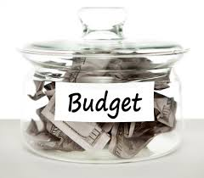
Key Dates
31 Oct 2016 | Communities submit budgets to STC Office (or get an extension)
Mid-Nov 2016 | Budget Review Committee starts confirming funding
31 Dec 2016 | All extensions must be received by STC.
Mid-Jan 2016 | STC Staff starts sending funds

Slide 7
Budget Template

Slide 8
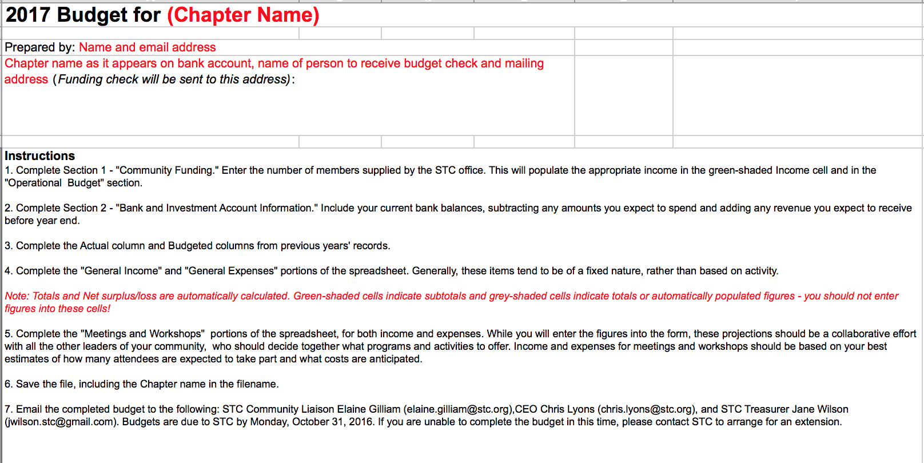
1. Complete Community Information

Slide 9
2. Enter Number of Members

Slide 10
3. Complete Account Information – current balances

Slide 11
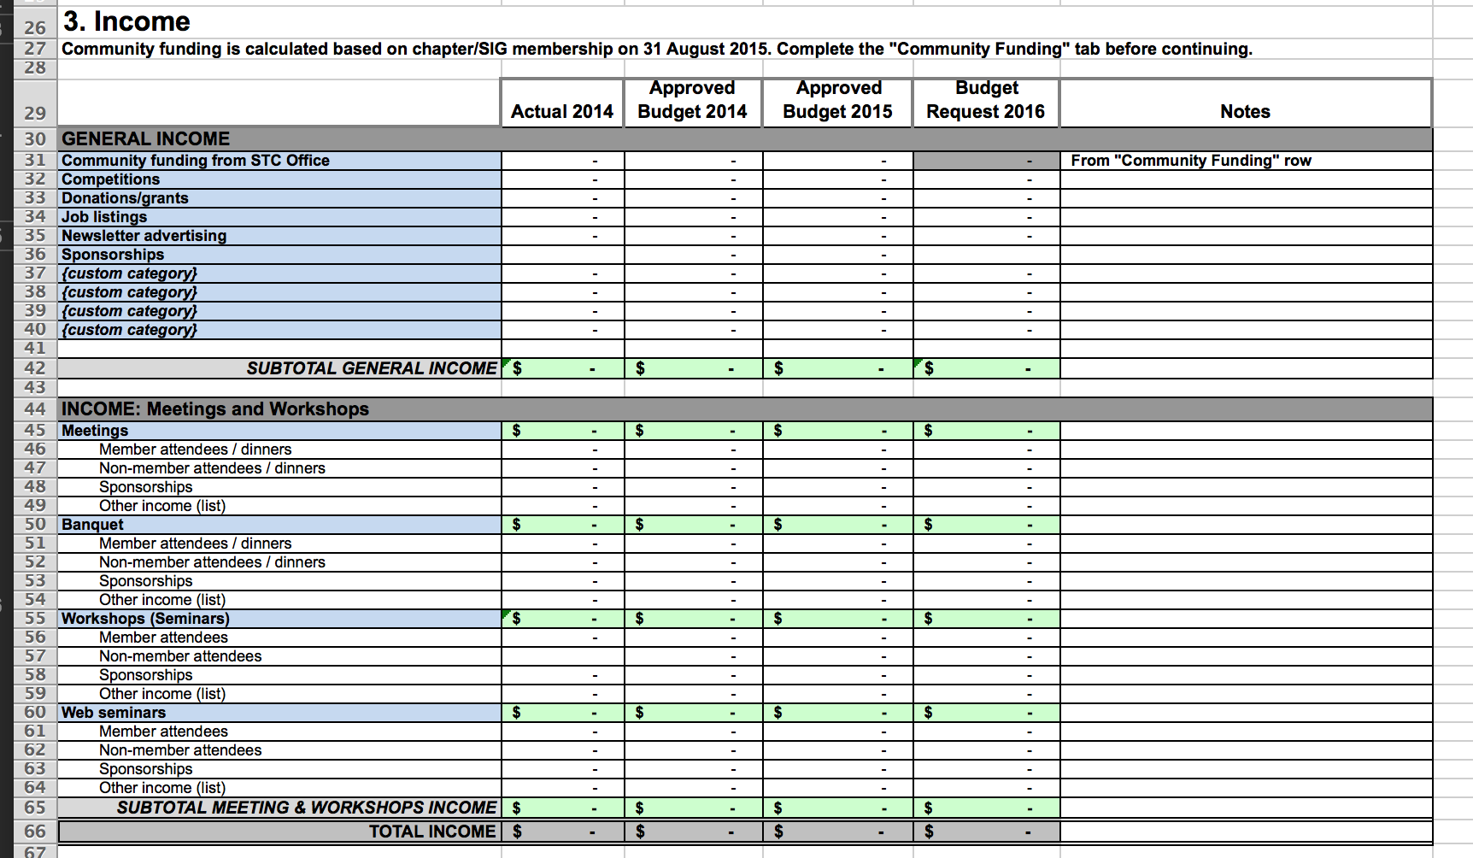
4. Complete Planned Income
Only enter information in white cells – green and grey cells are calculated!

Slide 12
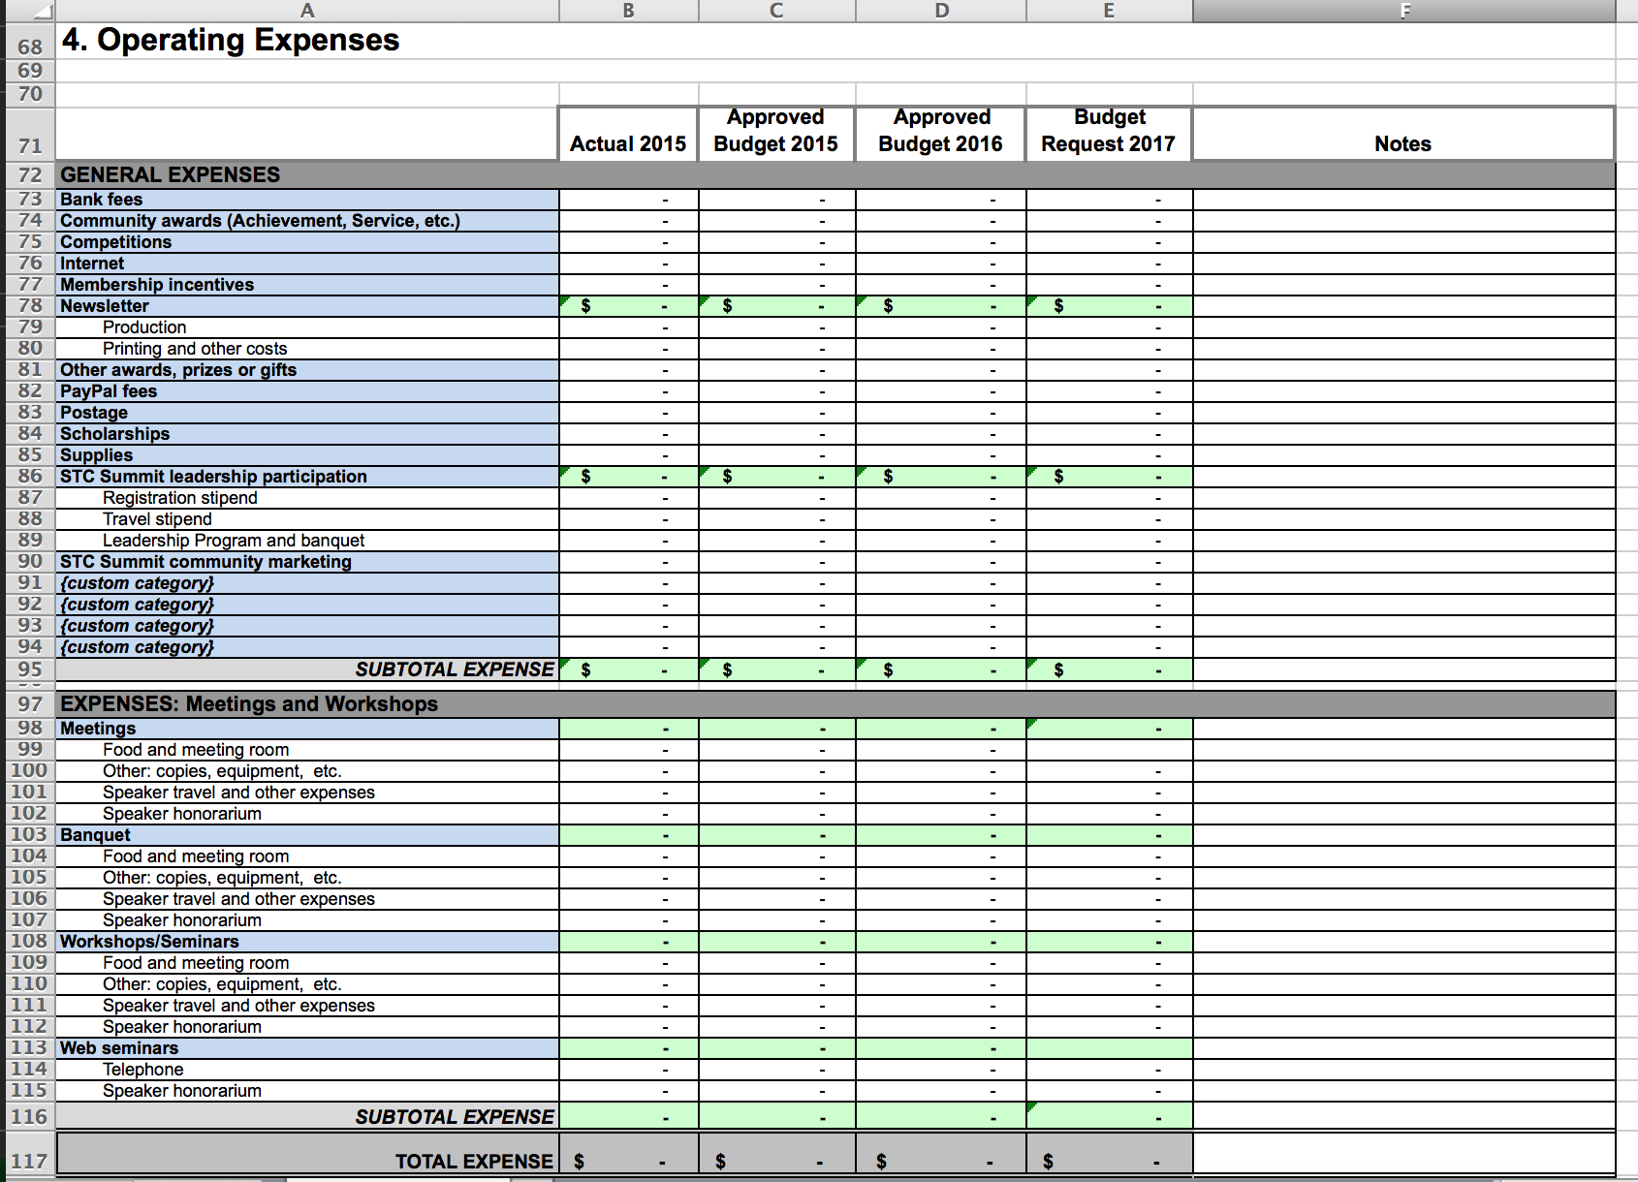
5. Enter Expenses – General and Meeting

Slide 13
6. Review Totals – Net Surplus/Loss

Slide 14
7. Review with Community Council 8. Submit to STC Elaine Gilliam, Community Relations Liaison elaine.gilliam@stc.org Jane Wilson, STC Treasurer jwilson.stc@gmail.com Chris Lyons, STC CEO chris.lyons@stc.org

Slide 15
Using Quicken to Speed Your Budgeting Timothy Esposito President, STC-Philadelphia Metro Chapter

Slide 16
What is Quicken?
Electronic check book
Generates reports for budgets and meetings

Slide 17
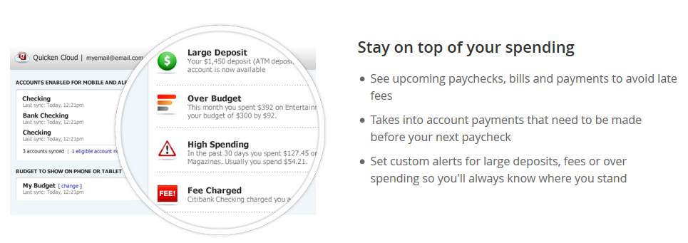
What is Quicken?
Downloads from your bank and PayPal
Comes in different flavors – “Basic” is fine for communities

Slide 18
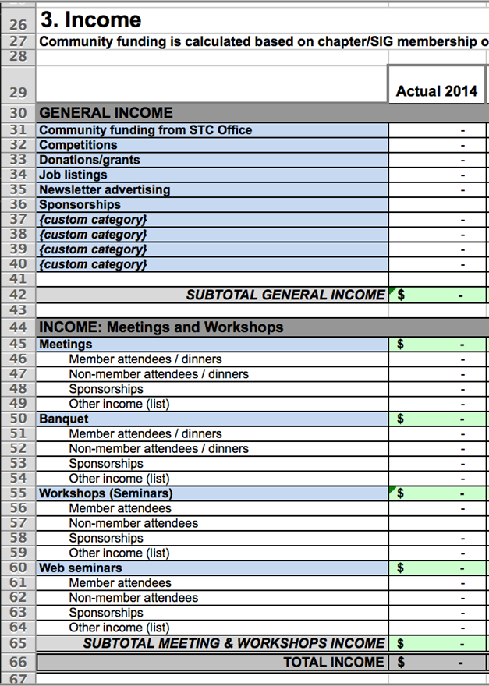
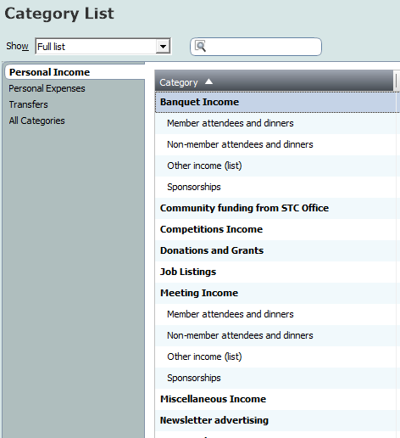
Duplicate Budget Categories

Slide 19
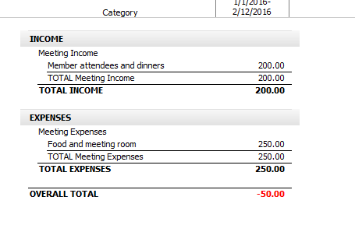
Quicken Reports
Many reports are available from monthly costs to annual budgets
Generate a budget report and copy the results into the Budget Form

Slide 20
More Details about Quicken
Article on www.cac-stc.org
Download a sample Quicken file
More detail about this presentation
http://www.cac-stc.org/simplifying-your-community-finances-with-quicken/

Slide 21
Questions & Answers

Slide 22
Resources
Jane Wilson, STC Treasurer
jwilson.stc@gmail.com
Tim Esposito, CAC Webmaster/Best Practices
tmesposit@gmail.com
Elaine Gilliam, Community Liaison
elaine.gilliam@stc.org
Cindy Pao, CAC Chair, STC Board of Directors
cindy@paofamily.com
Chris Lyons, STC CEO
chris.lyons@stc.org
Board of Directors
board@stc.org

