Slide 1
Event Planning 101
Presented by Carolyn Klinger & Viqui Dill
STC Community Affairs Committee (CAC) Friday, August 25, 2017 from 12:00 PM to 1:00 PM (EDT)
The program will begin shortly.
Please mute your phone until you have something to say.

Slide 2
General process
Think of a good idea for the program
Make arrangements
Consider virtual options
Set up online ticket sales in EventBrite
Promote the program
Deliver the program
Follow up with attendees and thank the speaker
Eventbrite demo!

Slide 3
Think of a good idea for a program
Call for community suggestions
Speakers
Topics
Conference presenters
Partnerships with other organizations
Online discussions on Basecamp and Slack

Slide 4
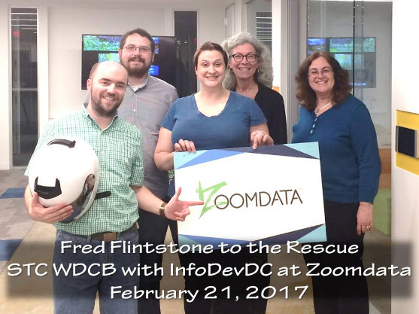
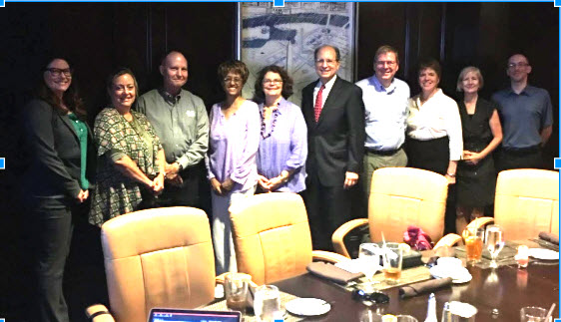
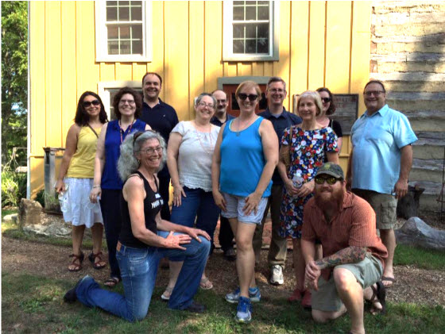
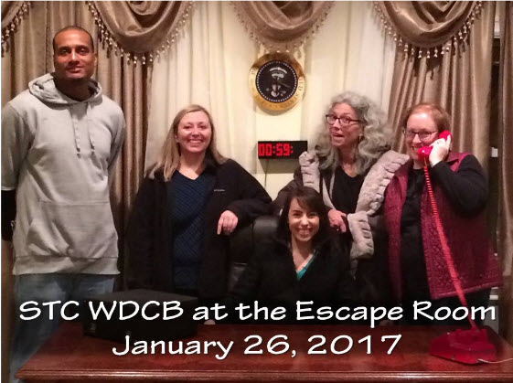
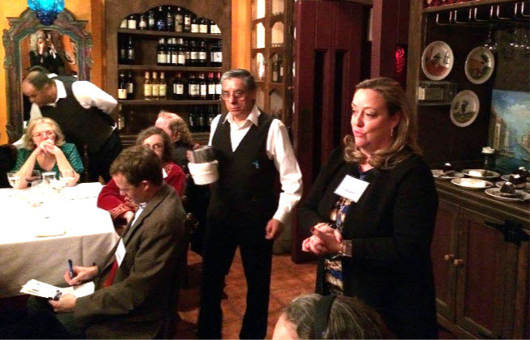
Make arrangements
Speaker
Topic
Venue
Food
Cost
Volunteers
Notes:
Speaker: Letter of Agreement
Venues: libraries, corporate space, restaurants
Food: platters, meet at restaurant later
Cost: Consider speaker honorarium or gift, venue cost, refreshments, and desired ticket price

Slide 5
Letter of agreement for speaker
Outlines what we need from the speaker:
Date and time of the event
Date for the rehearsal (for webinars)
Title of the presentation
Paragraph about the event (short description)
Paragraph about the speaker (short bio with name, credentials, and organization)
Photo at least 2160 x 1080 px (2:1 ratio) no larger than 10MB
Handout
PowerPoint slides (for webinars)
Notes:
The LOA outlines expectations for the webinar, stipend, future use of their presentation by the community, and other logistical information.
Usual agreement is $100 flat rate plus 10% of webinar. If more than one speaker, then a discussion with the community board needs to be done. NOTE: Community treasurer requests checks from the STC office.
Sometimes speakers will donate their stipend to the SIG, usually if the speaker is also a member.
The LOA needs to be signed (speaker types in name and date) and received before webinar takes place.
Keep the signed LOA in a shared Google Drive.

Slide 6
Consider virtual options
Skype
Adobe Connect
GoToWebinar
Tech tips for virtual events
Two laptops: one to advance slides in room and one to administer online interaction
USB microphone or conference phone
USB webcam to project speaker

Slide 7
Set up online ticket sales in EventBrite
Eventbrite Demo!
Notes:
Track registrations and respond to any questions

Slide 8
Promote the program
Use Eventbrite’s invitations and reminders
Biggest response
Website calendar
Social Media
Discussion lists
2nd biggest response
Partner organizations
STC’s Notebook blog
Notes:
EventBrite: Remember to turn on RSVP feature and send subsequent invitations only to those who have not responded

Slide 9
Preparing to deliver the program
Seek out volunteers to work the check-in table and set up food and room
Add volunteers to Basecamp
Update Basecamp about when to arrive and what to bring
Confirm all arrangements
Speaker
Venue
Food order
Respond to all queries in EventBrite
Continue promoting the program

Slide 10
Deliver the program
Bring what you need to the program:
Attendee list
Name badges
Pens
Speaker bio notes
Speaker gift
Door prizes
Community and STC literature
Record if possible
Take pictures
Publicly thank volunteers
Relax and enjoy the program!

Slide 11
Follow up with attendees and thank the speaker
Satisfaction survey through Eventbrite’s Survey Monkey extension
Prewrite and schedule the email
Update website with link to handout or slides
Special considerations for SIG speaker payments
Photos & video will boost future events
Post them somewhere you can find later

Slide 12
Resources
Organizing Meetings Using EventBrite
Using Eventbrite to manage your event registration webinar
Big Name Sticker Template with RSVP spreadsheet for mail merge

Slide 13
Thank you!
Contact us if you need help.
Viqui Dill viqui.dill@gmail.com facebook.com/Viqui.Dill @Viqui.Dill
Carolyn Klinger carolyn.klinger@verizon.net https://www.linkedin.com/in/carolynklinger/ @cklinger

