Slide 1
Great Programming for All of Us!
Leveraging Community Collaboration and Virtual Events
Ben Woelk
STC Rochester Co-VP and Spectrum Co-Chair STC Scholarship Committee Chair

Slide 2
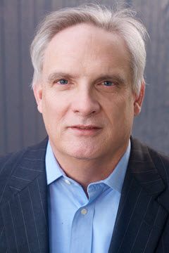
Your presenter
Ben Woelk
Introverted Leadership Coach and Mentor; Associate Fellow, Scholarship Committee Chair, Former Director, STC; Co-VP and Spectrum Co-Chair, STC Rochester; ISO Program Manager, Rochester Institute of Technology; Member and former Co-Chair, EDUCAUSE HEISC Awareness & Training Working Group; Security Guru; Introvert; INTJ; CISSP; CPTC; Author of Shockproofing Your Use of Social Media: Staying Safe Online (Kindle)

Slide 3
Outline
The problem
A proposed solution
Virtual Techcomm Showcase (Pacesetter Award)
What’s needed
A virtual workspace
Open discussion

Slide 4
Problem
Providing great programming
Barriers
No local SME
No local seasoned presenters
Tired of the same old, same old
Travel issues
Geographically dispersed
Weather

Slide 5
A Solution
Virtual programming
Community Collaboration
Multi-chapter events

Slide 6
Examples
Lightning Strikes Thrice (Carolina, SEM, Rochester)
Techcomm Virtual Showcases
Format
Three sponsoring chapters
One speaker per chapter
One chapter hosts virtual meeting
3 20+ minute presentations
Optional—in-person viewing parties/networking events

Slide 7
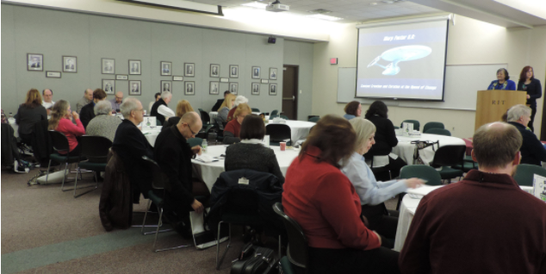
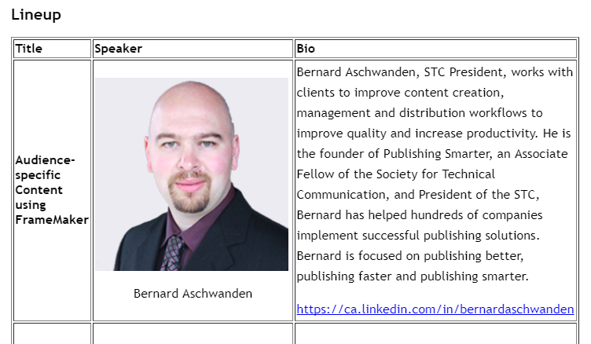
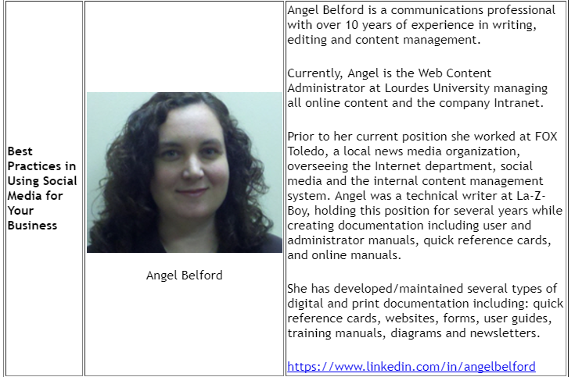

Slide 8
Components needed
Connect, BlueJeans, GoToWebinar, Webex, etc.
Eventbrite or other ticketing system
A moderator
Presenters
A discussion/planning area

Slide 9
Where do I find a presenter?
Conference programs/speaker lists (Summit, Spectrum, Conduit, Interchange, LavaCon, etc.)
Local experts
TC Speaker Bureau (http://techcommspeakersbureau.org/HomePage)
Local colleges and universities

Slide 10
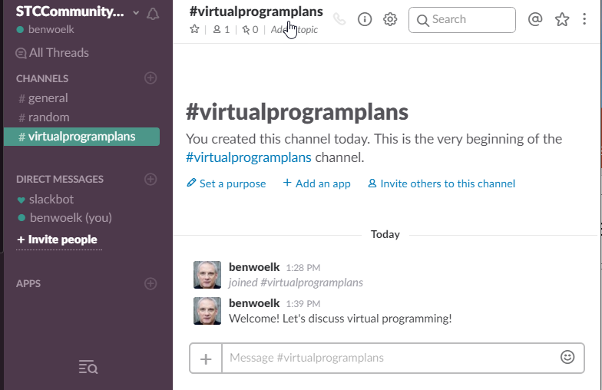
Workspace

Slide 11
Join the community program planning discussion on Slack
Slack
Invite link (good until 9/9/2017) https://join.slack.com/t/stccommunityprograms/shared_invite/MjI1MTQzMjk0NDUzLTE1MDIzODU4NTgtMzMxZDY0MzRiZA
Or send email to ben.woelk@gmail.com

Slide 12
Open Discussion
Experiences
Opportunities
Ideas

Slide 13
Connect with Me!
Ben.woelk@gmail.com
@benwoelk
https://www.linkedin.com/in/benwoelk
https://www.facebook.com/ben.woelk
Join the Introverted Leadership conversation on Slack.
http://benwoelk.com/

