Slide 1
Surely You Can’t Be Serious About Surveys
Jamye Sagan with Li-At Rathbun
CAC Leadership Webinar Series
July 28, 2017

Slide 2
Source: nodoubtern
Notes:
Credit: https://pics.me.me/Facebook-3052b6.png
Source: nodoubtern

Slide 3
Engage with us on Twitter during the webinar!
STC Community Affairs Committee: @STCCAC
Jamye Sagan: @gimli_the_kitty
Li-At Rathbun: @virtual_li

Slide 4
What We’ll Cover Today
Why Surveys?
Survey Tools
Best Practices: Demographic Surveys, Mini-Surveys, and Elections
Encouraging Participation
Notes:
Bullets appear all at once
About surveys: why they are important
Available survey tools
Best practices for conducting demographic surveys, mini-surveys, and elections. For most of this webinar, we’ll walk through several questions from the Instructional Design & How to encourage participation

Slide 5
Why Surveys?

Slide 6
Why Surveys?
Overall snapshot of membership base
Event feedback
Help earn Community Achievement Award points
Election of future community leaders
Search for potential volunteers
Topics for programming & publishing
Notes:
6 clicks total
Why even do surveys?
[CLICK] Overall picture of your community– capture the pulse of your membership
[CLICK] Get feedback on events – have a survey ready to capture this info after an event
[CLICK] Earning Community Achievement Award points: There may not be a separate line item for surveys, but the work from the surveys can greatly help you earn points in other areas such as overall planning, programs,
[CLICK] Determining future community leaders by using survey tools for elections
[CLICK] Soliciting potential volunteers
[CLICK] And determining topics for programming & publishing

Slide 7
Survey Tools
Notes:
Now let’s take a brief look at some of the tools used for conducting surveys, along with some pros and cons of each.

Slide 8
Tools
CHAT TIME: Do you already conduct surveys? If so, what tool do you use?
Available tools include:
Survey Monkey
Google Forms
Notes:
2 clicks total
[CLICK]
CHAT TIME: Do you already conduct surveys? If so, what tool do you use?
[CLICK]
Available tools include:
Survey Monkey
Google Forms
First we’ll chat about SM, then about Google Forms.

Slide 9
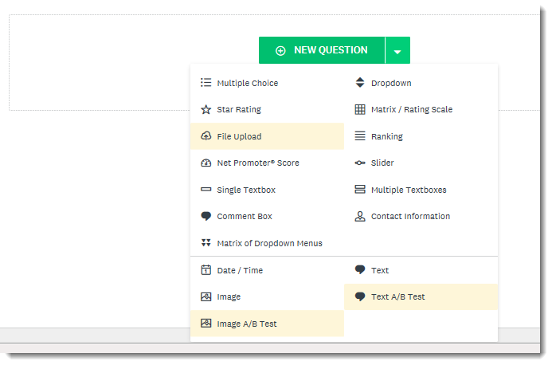
Survey Monkey: Survey Setup
Notes:
When you build a survey in Survey Monkey, you can either start from scratch or copy an existing survey.
the overall page consists of “web parts” (pardon the Sharepoint reference).
In each of these web parts, you can insert questions, images, and text.

Slide 10
Survey Monkey: Pros
Easy to use
Many question types available
Ability to insert images and other formatting elements
Ability to customize with logo/colors
Sharable (for editing purposes)
Simple and solid controls
Reusable elements
Attractive and easy-to-use analytics
Notes:
8 clicks total
Here are some pros of Survey Monkey.
[CLICK] Easy to use
[CLICK] Many question types available to you
[CLICK] Ability to insert images and other formatting elements -
[CLICK] Ability to customize with logo/colors
[CLICK] Sharable (for editing purposes) – if you have the tool login, you can access all the surveys. SO make sure only key folks have the login info.
[CLICK] Simple controls - for example, can configure survey so only one user per IP address can take survey, automatically set survey closing time, etc.
Reusable elements – copy and paste (and edit) either whole surveys, or individual Qs
Attractive, clear analytics – save as PDFs with colorful graphs and freeform text in easy-to-read tables.
Another benefit not mentioned here: a new feature in SM is smooth scrolling, where one Q appears at a time. This makes it easier for mobile users to take your survey, hopefully increasing response rates.

Slide 11
Survey Monkey: Cons
Expensive
Over $400 annually
Free version – limitations
Possible discount for non-profits
Opportunity: sponsorship!
Can take awhile for initial setup
Notes:
2 clicks total
[CLICK]
BIGGEST CON: expensive.
Plans we use run about $35 per month, or $420 annually.
SM does have a free version, but you are limited to 10 questions per survey, and 100 responses to survey, and cannot customize with your logo. Unlimited surveys, though.
SM program where non-profits can apply for a 25% discount.
One area of opportunity is to garner sponsorship support to pay for your SM.
[CLICK]
Initial setup: You have so much flexibility and options in formatting, it can take awhile for initial setup. You can easily get overwhelmed or indecisive. But once you invest the time in setting up a particular survey type, copying and reusing the template is very quick.
Now Li-At will share with us some information about Google Form surveys, as well as pros and cons.

Slide 12
Google Forms: Basic Form
Notes:
Li-At: Here’s what the basic form looks like.
This is what we build everything from.

Slide 13
Google Forms: Sample Survey View #1
Notes:
Li-At: Here’s what a Google Forms survey looks like, or one of the ways it can look when users come to the survey.
Intro page

Slide 14
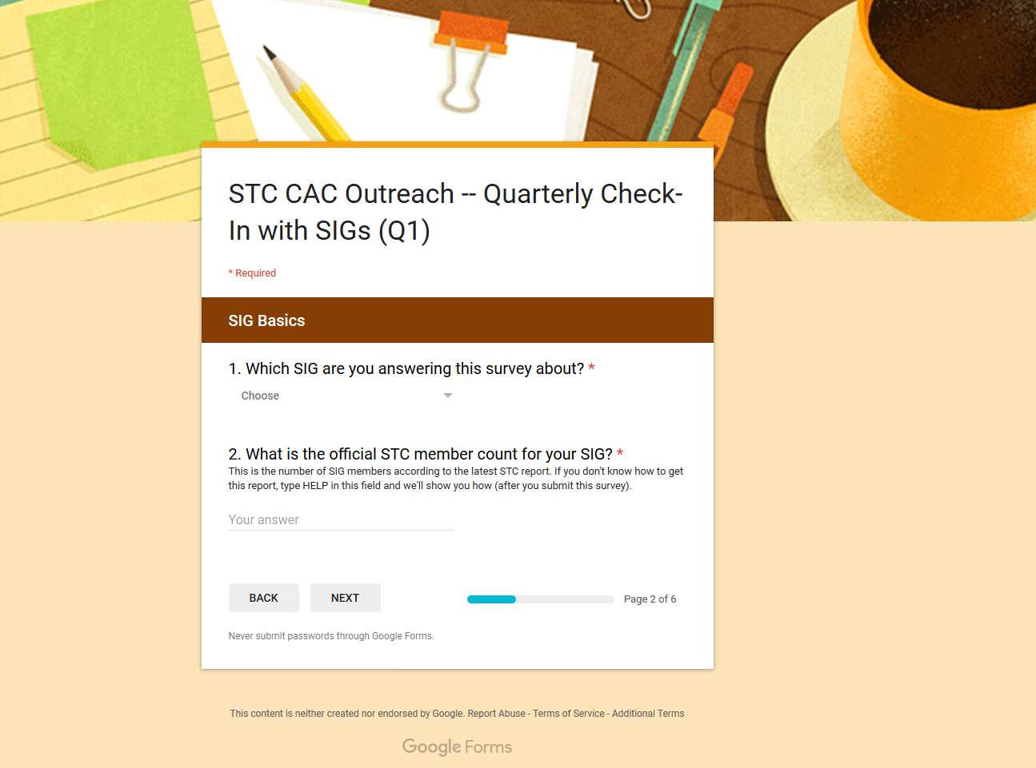
Google Forms: Sample Survey View #1
Notes:
Li-At: Here’s what it looks like, or one of the ways it can look when users come to the survey.
Sectioned questions

Slide 15
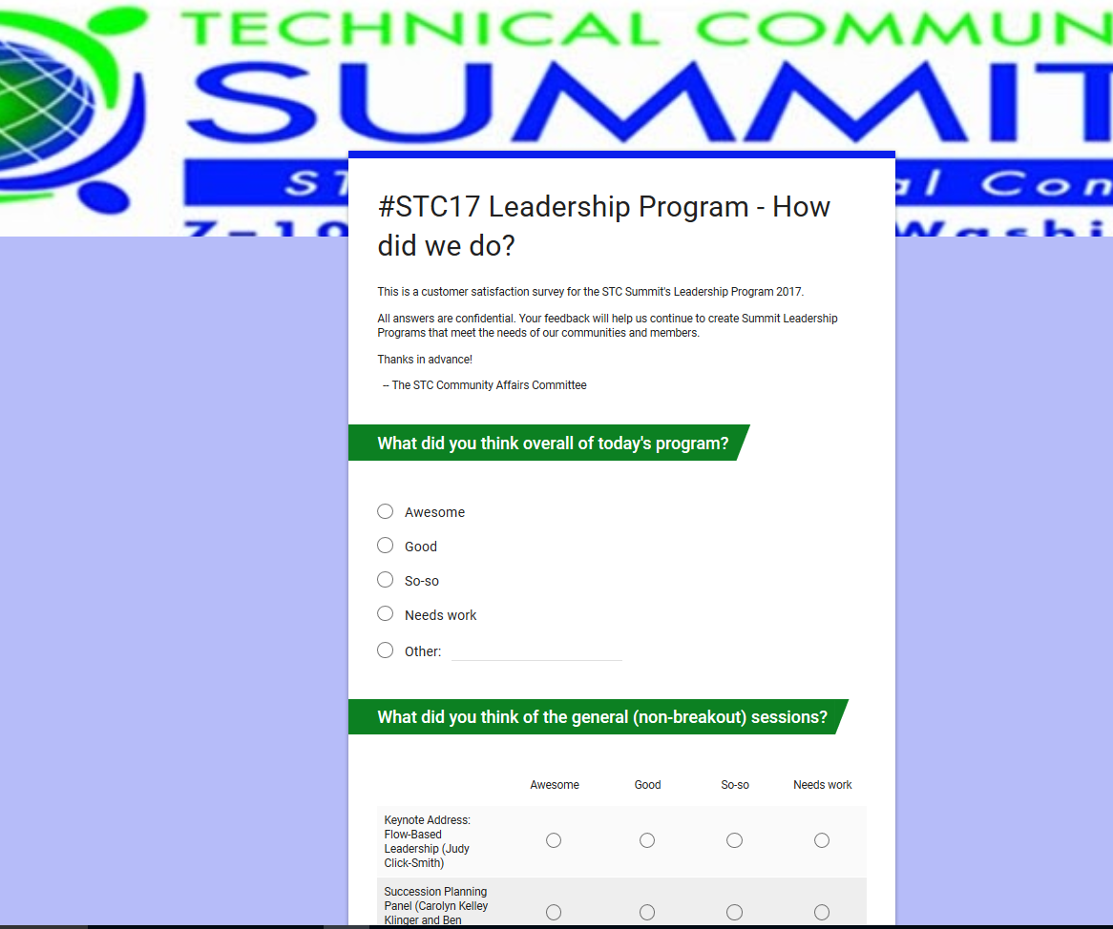
Google Forms: Sample Survey View #2
Notes:
Li-At: Here’s another way it can look.

Slide 16
Google Forms: Pros
Free
Familiar
Sharable—multiple contributors
Repeatable—start with a copy
Pretty analytics
Notes:
5 clicks total
Li-At: Pros:
[CLICK]Free
[CLICK]Familiar (somewhat)
[CLICK]Sharable—multiple contributors
Caution: designate final decision-maker
Caution: designate parameters for acceptable changes, or at notification about the changes
[CLICK]Repeatable—start with a copy
[CLICK]Pretty analytics

Slide 17
Google Forms: Cons
Anyone with the link can edit
Stay vigilant to what changed
Copy limited to same folder
Open/response rate (careful what email you send this from)
Easy to make survey too long
Spreadsheet results are ugly
Notes:
6 clicks total
Cons:
[CLICK] Anyone with the link can edit (if you set it up that way)
[CLICK] You may not notice that someone changed something, or may not recall what it’s supposed to look like
[CLICK] Email address this comes from
[CLICK] Don’t make it too long
[CLICK] Long spreadsheet answers (in raw format)
[CLICK] Copy limited to the same folder. If you want it elsewhere, you need to redo the form

Slide 18
Best Practices: Demographic Surveys
Notes:
Now that we have a basic orientation of these two survey tools -In this section, let’s walk through parts of a successful demographic survey, to see what types of questions work best.
Since I’m also the Survey Manager for the Instructional Design & Learning SIG, we’ll use that as an example.
Regardless of which survey tool you use, you can follow these tips to set up your questions. In this example, we use Survey Monkey.

Slide 19
Question Types
Experience & Employment
Deliverables
Tools
STC & Other Professional Membership
Services and Communication Value
Topic Ideas
Feedback: Specific Events
STC Summit
Volunteers
Notes:
This is just a summary list of some of the question types we’ll cover over the next several slides.
This will be by far the longest section of the webinar, but it’ll still go by fairly quickly.
For each of the next 17 slides, I’ll give the question (whether from the analytical summary or SM guts), why we ask that question, and what question type to use when setting up the survey.

Slide 20
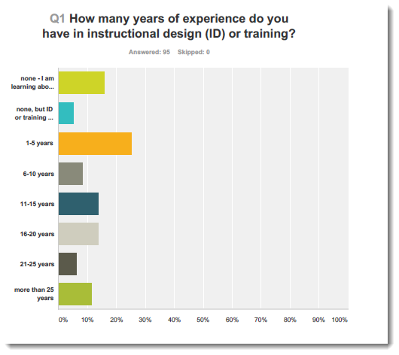
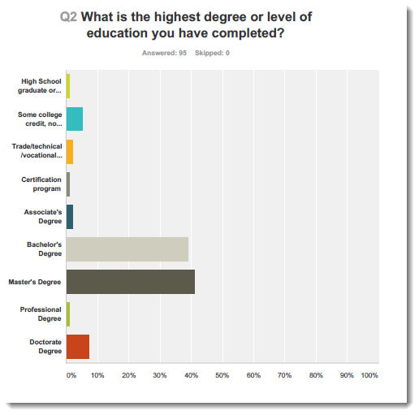
SURVEY QUESTION: Experience & Employment
WHY? Novice vs. expert info
Q TYPE: Multiple choice, one answer
Notes:
Experience and employment:
Years of experience: Lets us know whether our members are novices or experts. Since most of our members are more on the novice spectrum, we plan for more beginner-level programming.
Education level: Idea of who may be interested in furthering their education; we can promote schools.
Question type: Multiple choice, one answer

Slide 21
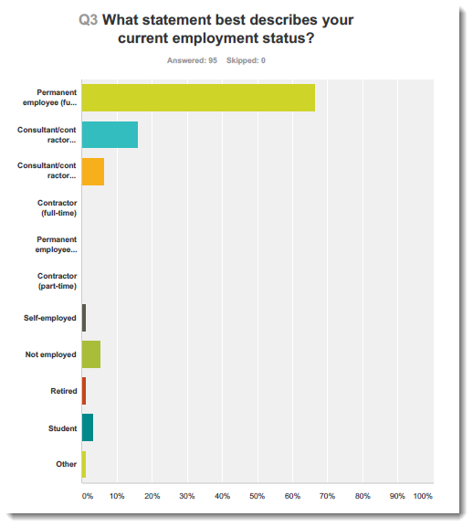
SURVEY QUESTION: Experience & Employment
WHY? Employment resource focus
Q TYPE: Multiple choice, one answer
Notes:
Current employment status
Useful information.
For example, if most of your members are contractors, you could find more materials geared toward them. Perhaps even encourage those members to join the Contractor and Independent Consulting SIG. Or focus more on job banks and posting jobs
Q TYPE: Multiple choice, one answer

Slide 22
SURVEY QUESTION: Experience & Employment
WHY? More useful info to determine programming content
Q TYPE: Checkbox option, multiple answers
Notes:
Job responsibilities
more info about our members' employment and interests.
For instance, if most of your members are project managers, you could gear more programming or articles towards them.,
Q TYPE: Since members may have different responsibilities throughout their careers: Checkbox option, multiple answers.

Slide 23
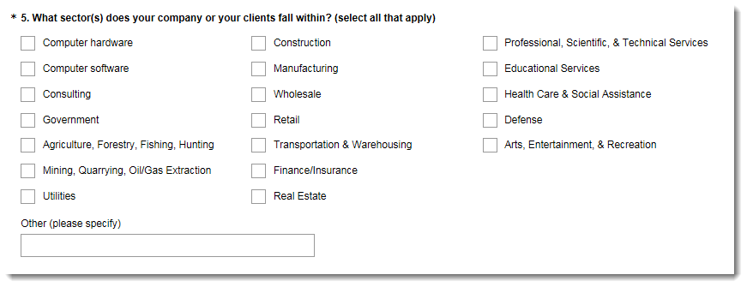
SURVEY QUESTION: Experience & Employment
WHY? More useful info to determine programming content
Q TYPE: Checkbox option, multiple answers
Notes:
Company Sectors:
More useful info to determine programming content geared toward a specific industry such as pharmaceuticals (yet still applicable to other industries)
Use checkbox option so user can select more than one answer.

Slide 24
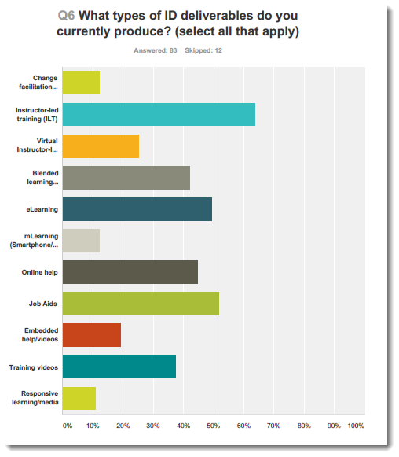
SURVEY QUESTION: Deliverables
WHY? See what members produce, and what’s new
Q TYPE: Checkbox option, multiple answers, with freeform answer
Notes:
Asking what deliverables our members produce is not only useful to see what our members actually produce, but also learn about new deliverable methods.
QUESTION SETUP: Checkbox option, Include freeform “other” answer so users can type in answers

Slide 25
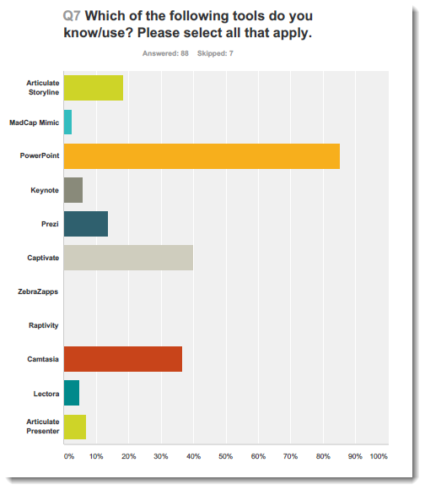
SURVEY QUESTION: Tools
WHY? See what tools are popular, not as popular, or new
Q TYPE: Checkbox option, multiple answers, with freeform answer
Notes:
Like deliverables, asking what tools your members use is great for seeing not only what tools they use, but also to see what new tools are out there and which tools are becoming obsolete.
QUESTION SETUP: Use a checkbox "select all that apply" question type with freeform blank, just like the tools Q.
Example: Over 80% of our members use PowerPoint. One of our webinars from last year discussed new ways of using PP.

Slide 26
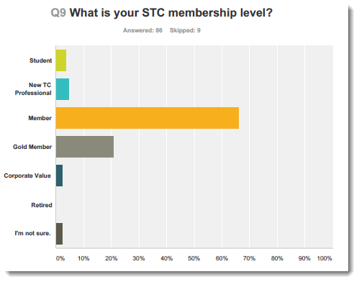
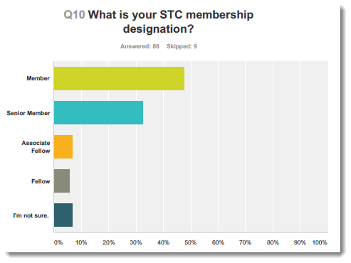
SURVEY QUESTION: STC Membership
WHY: Membership makeup
Q TYPE: Multiple choice, one answer
Notes:
Asking members about their STC (and other professional organization) membership gives us an idea of our member makeup.
For SIGs, this question helps us see how many members specifically joined our SIG vs gold membership (where they may have just joined by default, since gold membership gives you membership in all the SIGs)

Slide 27
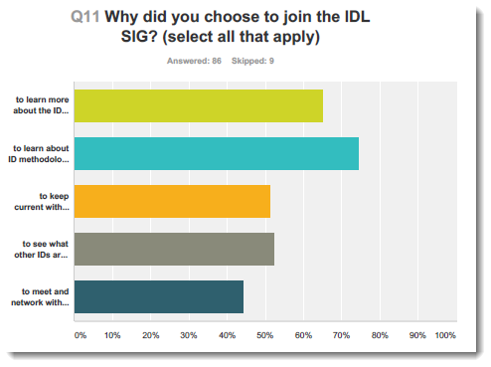
SURVEY QUESTION: Community Membership
WHY? Goals checkpoint
Q TYPE: Checkbox option, multiple answers, with freeform answer
Notes:
Asking why people joined your community: Good checkpoint to make sure you are following your mission statement and goals
Q TYPE: Checkbox option, multiple answers, with freeform answer.

Slide 28
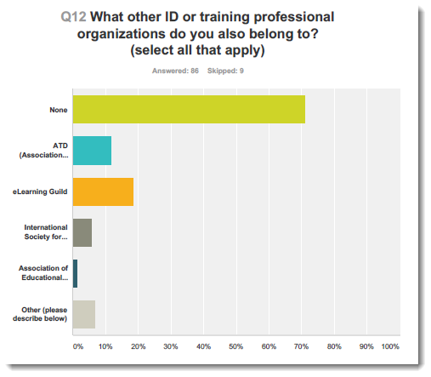
SURVEY QUESTION: Other Professional Organizations
WHY? Compare with other orgs
Q TYPE: Checkbox option, multiple answers, with freeform answer
Notes:
Asking about other professional organizations helps us see how we compare to them, and to learn of new ones.
This question is probably easier with SIGs since you can narrow lists down by specific topic.
Get a list of other groups, so you can comparison research them
Q TYPE: Checkbox option, multiple answers, with freeform answer.

Slide 29
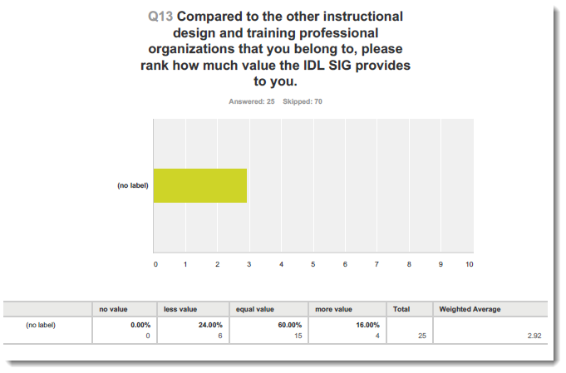
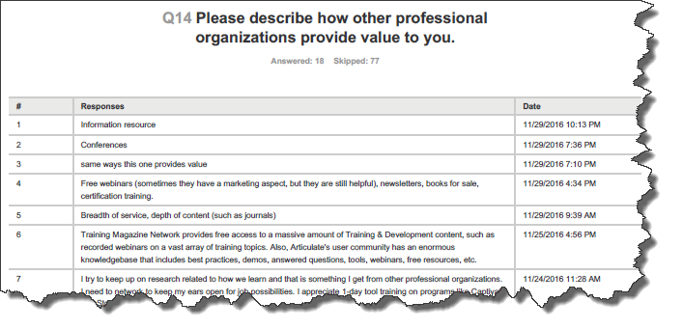
SURVEY QUESTION: Other Professional Organizations
WHY? ID opportunity areas
Q TYPE: Likert scale
Notes:
The first Q here specifically asks the member to compare their STC community with other professional organizations.
The next question gives the member a chance to explain. Sometimes, responses are not pretty to hear, but they help us pinpoint areas of opportunity.
Tip: Free-form questions may be more challenging to analyze, but they are valuable since they enable respondents to give detailed feedback they could not otherwise give.

Slide 30
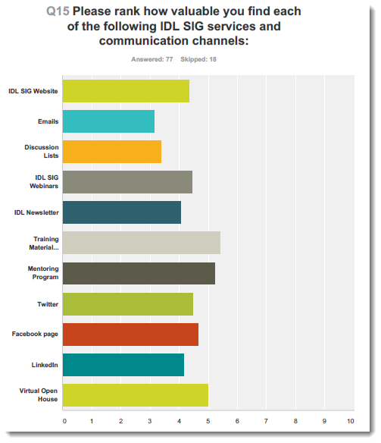
SURVEY QUESTION: Service & Communication Value
WHY? Determine value
Q TYPE: Likert scale
Notes:
SEGUE: SERVICE AND COMMUNICATION VALUE
This particular question asks the member to determine how valuable they find your community’s services and communication channels
When formulating this type of question:
List all the services and programs you offer.
List all of your communication channels (email, social media)
Use a Likert scale question so users can compare each item in itself.
Do not use a “best to worst” scale type of question here. The only time you should use a ranking question is if you’re ranking effectiveness and need to either scale back or re-direct focus on something.

Slide 31
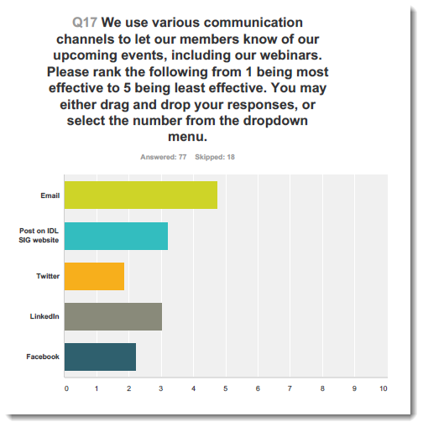
SURVEY QUESTION: Service & Communication Value
WHY? Gauge value for one event type
Q TYPE: Best-to-Worst Ranking
Notes:
In this instance, we did use a “best to worst” ranking question because we were comparing only one thing – communication channels for our webinars.
For example, we found that our members found email notifications most effective when learning about our webinars, with Twitter being the least effective communication channel.

Slide 32
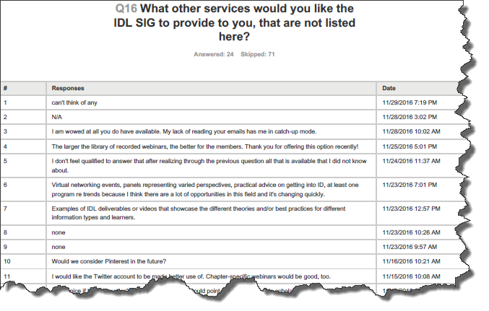
SURVEY QUESTION: Service & Communication Value
WHY? Ideas
Q TYPE: Freeform text
Notes:
We added this freeform text question to obtain ideas for future community services – a big brainstorm so to speak.
Q TYPE: Freeform text

Slide 33
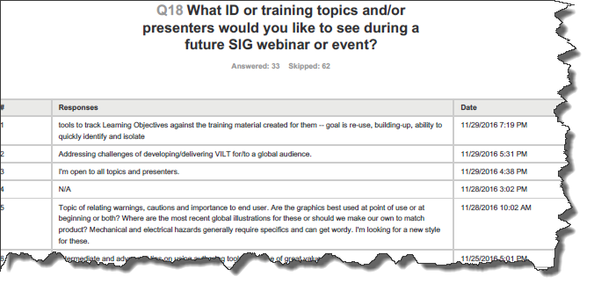
SURVEY QUESTION: Topic Ideas
WHY? Ideas
Q TYPE: Freeform text
Notes:
Just like the “What other services” question, this “topic ideas” freeform text question gives your programs team a wealth of info for future programs or articles.
Q TYPE: Freeform text

Slide 34
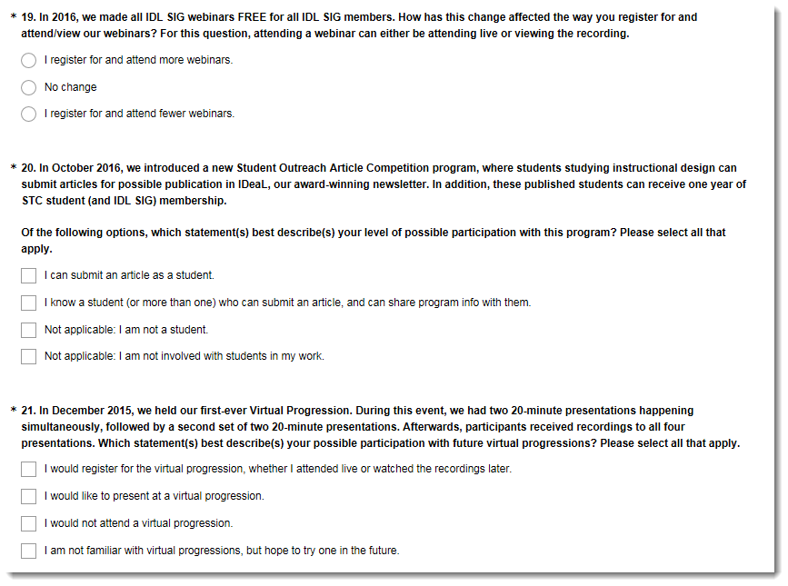
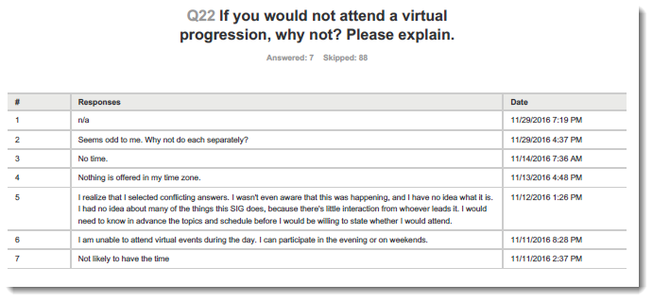
SURVEY QUESTION: Feedback on Specific Events
WHY? Get feedback
Q TYPE:
Multiple choice, one answer
Checkbox, multiple answers
Notes:
You can also insert questions about specific events & happenings.
For example, we asked one question about making IDL SIG webinars free for our members affected the way you register for and/or attend/watch the webinars?
Another question centered on our student article outreach program, to get a feel for how many of our members would be eligible for such a program, or would know someone who is.
Another question was seeking interest about our December 2015 virtual progression, and what statement best describes your possible participation with future virtual progressions.
For evaluation purposes, though, you still want to ask such questions via survey immediately after

Slide 35
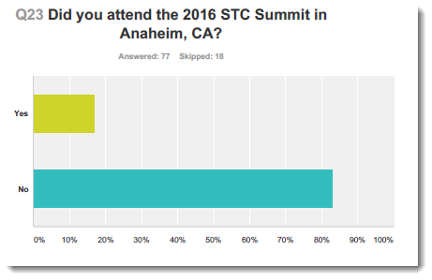
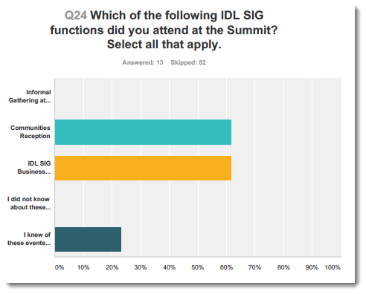
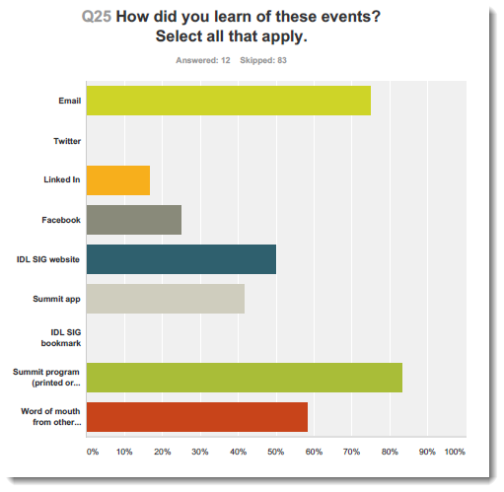
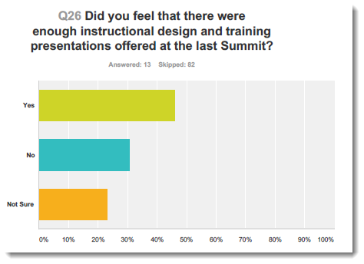
SURVEY QUESTION: STC Summit
WHY? Gauge outreach effectiveness @ Summit
Q TYPE: Checkbox, multiple answers
Notes:
We even included a section on Summit attendance – if user answered no, we set up conditional formatting to skip user to the next section.
For those who did attend Summit, we asked a few questions about SIG-related events (such as business meeting, communities reception, any informal outings), how they learned of these events, and if there were enough specific-category presentations offered (this one, we would not have much control over since we are not involved in the selection process. The only way t we would have control is to submit proposals)
In retrospect, this topic would've made a much better mini survey. Speaking of which…

Slide 36
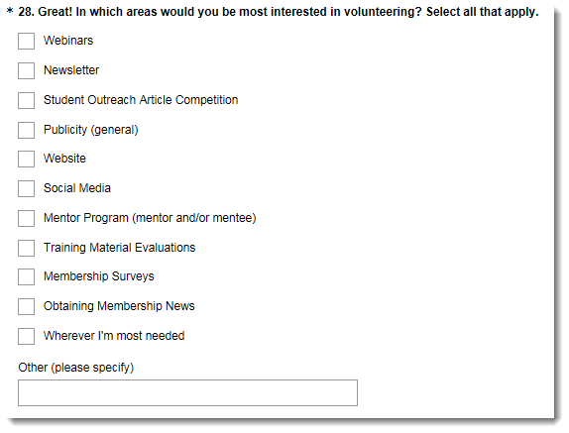
SURVEY QUESTION: Volunteers
Branching for 1st question
List area(s) of opportunity
Fields for name & email
Notes:
Demographic survey – nice way to solicit potential volunteers. Especially valuable for SIGs, who don’t have the same F2F opportunities as chapters
We’ve actually gotten a few volunteers this way.
So we have our options – set up conditional formatting to go to the next set of Qs if user answered No, or already volunteer.
But if user clicks on the yes or maybe options, this question appears [CLICK to display Q28]. We list pretty much what volunteer opportunities are available, from our website.
Then user inputs name and email. We collect all this info, divvy it up among the different committees, and they take care of following up.

Slide 37
Best Practices: Mini Surveys & Elections

Slide 38
Best Practices: Mini-Surveys
2-3 questions max
One specific relevant topic
Short – no more than 5 minutes
Notes:
[CLICK]

Slide 39
Best Practices: Election
CHAT TIME: What tool do you currently use for conducting elections?
Keep ballots secure.
Send link out only to members
Poll settings: one per IP address
Use template: one time set-up.
Candidate photo and bio
Ballot
Can copy and reuse for future elections
Notes:
[CLICK #1 of 3]
CHAT TIME: What tool do you currently use for conducting elections?
[CLICK #2 of 3]
Keep ballots secure.
Send link out only to members.
Poll settings: one per IP address
[CLICK #3 of 3]
Use template: one time set-up
Candidate photo and bio
Ballot
Can copy and reuse for future elections

Slide 40
Some Overall Best Practices
Try to remain consistent across questions and across iterations (surveys repeated over time).
If the list of options is exhaustive, provide all options as part of question.
Notes:
Li-At’s Overall best practices (2 clicks total)
[CLICK]
As for best practices: try and be consistent across questions and across iterations (surveys repeated over time). What I mean is:
1. If you have rankings in questions (awesome, good, bad, so-so, etc), use the same ranking in various questions.
If you know you'll want to survey this group again in future to gauge how the answers change over time, keep that in mind when you create the form, and keep the form as consistent as possible year over year (or quarter over quarter, or whatever).
[CLICK]
If the list of options is exhaustive, provide the all options as a part of question. For example:
* If we're asking the person what SIG they're part of, just have all the SIGs listed as multiple-choice options (or "Drop-down options" in Google Form). * If we're asking the person which event was their favorite, then have all events listed as multiple-choice options (or "Drop-down options" in Google Form).

Slide 41
Encouraging Survey Participation
Notes:
Now that you have this great survey, how do you get people to respond?
Here, we will share a small secret of success for getting survey participation, We also will talk about what to do before, during, and after

Slide 42
A Little Bribe Never Hurts
Offer monetary incentive
Example: electronic gift card(s)
In survey: have user submit name and email address.
When selecting winner:
Export results to Excel if entries are not already numbered.
Use random integer tool to select winner(s).
Dispersing prize
Chapter: Use own acct.
SIG: Contact front office.
NOTE: Be sure to build incentive(s) into your budget!
CREDIT: flicklives.com
Notes:
4 click total
In this scene from A Christmas Story, Ralph gives his teacher a gigantic fruit basket, in an effort to bribe her into giving him a good grade on his assignment.
Sometimes, it’s difficult to encourage users to take our carefully-crafted surveys. So we need to offer our fruit baskets. Not necessarily literally, but…
[CLICK]
One secret is to offer a monetary incentive
Example: two $50 Amazon electronic gift cards for members to complete our demographic survey
[CLICK]
In survey, invite user to submit name and email address.
[CLICK]
Export results to Excel if entries are not already numbered.
Use random integer tool such as www.random.org to select winner(s)
[CLICK]
When dispersing prize:
Chapter: Use own bank acct.
SIG: Contact front office; they can use the society CC to purchase and send gift cards.
NOTE: Be sure to build incentive(s) into your budget!

Slide 43
Drawing setup: Survey tool
Add blanks for name and email
Note the “token of appreciation” phrase!
Notes:
Use branching to set up fields. If user selects no, go to end of survey. If user selects yes, open Q asking for name and email.

Slide 44
Use & Share the Feedback!!
Read all feedback
Heed it when possible!!
Make results visible
Notes:
Beyond offering extrinsic rewards, we can encourage survey participation by enabling our members to see that their feedback DOES count.
[CLICK]
Read all feedback
[CLICK]
Heed it when possible!!
[CLICK]
Publish your results
To help make the best use of the gift of feedback, let’s look at some best practices for conducting the survey – before, during, and after.

Slide 45
Conducting Survey: BEFORE
1. Build survey
Compose questions & define branching scenarios.
2. Test survey
Have 2-5 members test survey.
Check question wording (can be done beforehand) and branching questions.
Time survey for accurate results.
Keep surveys to 10-15 minutes max, even demographic ones. Otherwise, users may lose interest.
Keep short enough to complete in one sitting.
Notes:
2 clicks total
[CLICK]
Build your survey
Determine questions
Map out branching scenarios, if any. NO sense making users answer questions that don’t apply to them.
[CLICK]
Have 2-5 team members test out the survey
Make sure branching scenarios work properly
Questions make sense
Gauge how long it takes to complete the survey
Survey length? 10-15 minutes max.
Any longer, and users will lose interest.
Even demographic surveys should be short enough to complete in one sitting.

Slide 46
Conducting Survey: DURING
3. Send email to intended audience
Survey purpose, link, deadline
ALWAYS inform user of survey length - demonstrates respect for their time.
4. Keep eye on response rate
Low response? Share link on community website.
BEWARE! Consider risks of non-members answering the survey.
Incentives (if any)
Notes:
2 clicks total
[CLICK]
Send email to members only. Use your members mailing list. In this email:
BRIEFLY explain survey purpose.
Provide survey link.
Communicate survey deadline.
ALWAYS let user know how long the survey should take: demonstrates respect for their time.
[CLICK]
Keep eye on response rate. Survey tools should give you this info.
If low response: consider sharing link on community website.
BEWARE! Consider risks of non-members answering the survey (although Q about STC membership may stave that off)

Slide 47
Conducting Survey: AFTER
5. Share survey results
Post results on community website.
Write analytic blog or newsletter article.
IMPORTANT: If you solicited any personal info (including people’s names and email, do NOT include that in the survey results).
6. Review & use feedback
Review during admin council and/or planning meetings.
Share pertinent info with each committee volunteer.
Notes:
2 clicks total
[CLICK]
Share survey results with community.
Generate PDF report of raw results and post on community website
Write blog or newsletter article
IMPORTANT: If you solicited any personal info (including people’s names and email, do NOT include that in the survey results)
[CLICK]
Make sure admin council / community leaders review the survey and use feedback accordingly.

Slide 48
Notes:
https://parade.com/273375/joelkeller/16-of-the-most-famous-movie-questions-of-all-time/#gallery_273375-12

Slide 49
Contact us!
Jamye Sagan
jamye.sagan@gmail.com
@gimli_the_kitty
Li-At Rathbun
stc.liat@gmail.com
@virtual_li
Community Affairs Committee
cac@stc.org
@STCCAC
Notes:
Reformat page.

