Slide 1
You Too Can Easily Start a YouTube Channel
STC Community Affairs Committee (CAC)

Slide 2
About Me
VP of Programs for STC San Diego Chapter since July 2015
Technical Writer & Editor for 10+ years
www.sarafeldman.com/about

Slide 3
Important Disclaimer
I am NOT a social media or YouTube expert.
Notes:
YouTube Best Practices
SEO

Slide 4
Why YouTube?
Over a billion users — almost 1/3 of all people on the Internet
2nd largest search engine — more than Bing & Yahoo! combined
Fun way to enhance your chapter marketing efforts
Sources
https://www.youtube.com/yt/press/statistics.html
https://trackmaven.com/blog/6-best-practices-to-optimize-your-youtube-channel

Slide 5
Pop Quiz!
Have you ever uploaded a video to YouTube?

Slide 6
Outline
YouTube Channel Setup
Create Videos
Method 1 – Picture Slideshow
Method 2 – PowerPoint saved as .mp4
Video Extras & Recommendations
Wrap-Up

Slide 7
YouTube Channel Setup
Find step-by-step guide here: YouTube Channel Setup

Slide 8
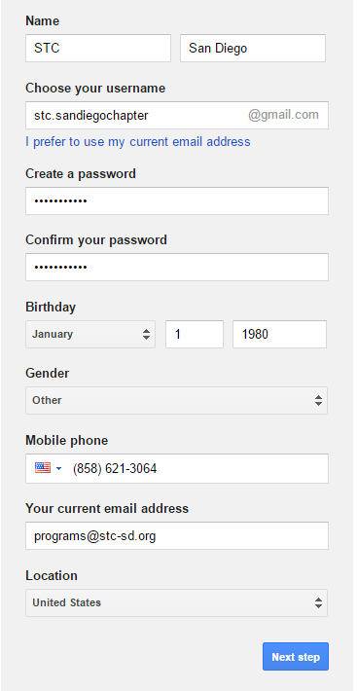
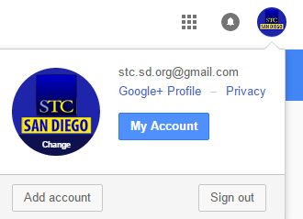
YouTube Channel Setup
Create Google account
Agree to terms > Prove you’re not a robot
Don't worry too much about Gmail username
Upload profile photo
Top right corner > click Change
Square image displayed as circular – see template
Set up "My Channel"
Go to www.youtube.com > My channel
Enter name for Use YouTube as…
Notes:
Don't worry too much about Gmail name. Display name can always be changed.
Enter name for "Use YouTube as" (discuss what's best for naming convention)

Slide 9
YouTube Channel Setup
Configure your channel
Add channel art
Channel description
Verify your channel
Creator Studio > Channel > Status and features > Verify
Verify via text or phone call
Associate your website
Required to use interactive cards & end screens
Advanced settings > Google Webmaster Central > WordPress Admin
See step-by-step guide
Notes:
Verify via phone Note: I prefer text verification over phone call but it said I used my number too many times but selecting phone call let me still use it.

Slide 10
Create Videos
Method 1 – Picture Slideshow
Method 2 – PowerPoint saved as .mp4

Slide 11
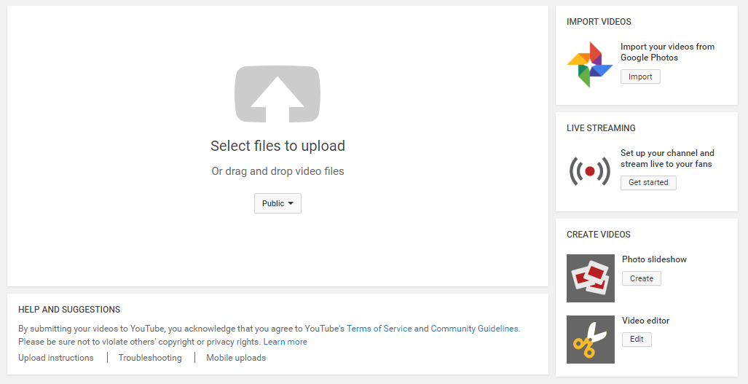
Create Videos
Method 1 – Picture Slideshow
Upload icon > Create Videos > Photo slideshow > Create

Slide 12
Create Videos
Example 1 – Basic Upload
Example 2 – Advanced Editor
For most settings, 1 choice for all pictures
Audio has “Fit to music” option
For most settings, choose per slide
Option to add text
Method 1 – Picture Slideshow

Slide 13
Create Videos
Method 2 – PowerPoint saved as .mp4
Upload icon > Select files to upload > choose .mp4 file

Slide 14
Video Extras & Recommendations
End screens, Cards, Enhancements

Slide 15
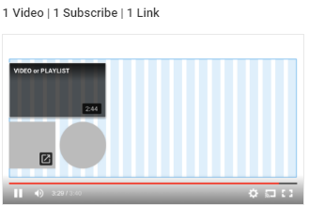
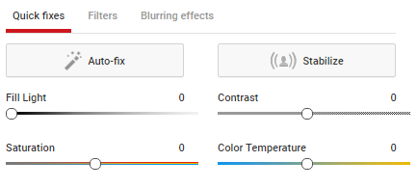
Video Extras & Recommendations
End screens
Show during the last 5-20 seconds of video
Add up to 4 elements (1 must be video/playlist)
Cards
Add interactivity to your videos w/custom images, links, CTAs
Can only point t0 associated website
Enhancements
Auto-fix, light/contrast, slow motion, timelapse, trim video, filters, blurring, etc.

Slide 16
Video Extras & Recommendations
PowerPoint Tips
Use templates
Leverage PowerPoint Designer – highly recommended!
Include slide transitions
Set slides to advance automatically by time

Slide 17
Channel & Video Options
Custom URL
Explore other features
Share on social media
Embed on your website
Recommendations
Optimize for Mobile
Plan ahead for end screens
Explore YouTube Audio Library to choose song before uploading
Incorporate high-quality stock photos (Pixabay, Unsplash)
Upload as Unlisted – make Public once all changes are done
Consider YouTube best practices from Google and Blogs
Video Extras & Recommendations

Slide 18
Wrap-Up
Private Google+ Community – STC Chapter Leaders
Ping me anytime!
Please subscribe to the STC San Diego YouTube channel!
Questions?

